Slide 1
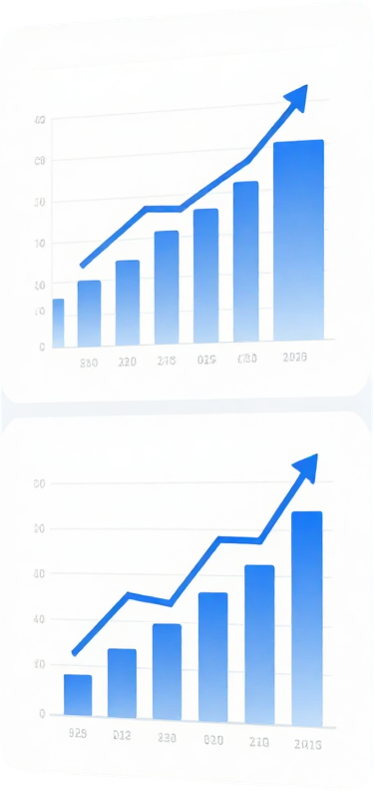

Data Analytics
E-Commerce Sales Analytics Dashboard
Power BI Dashboard Project
A comprehensive analysis of e-commerce sales data using Microsoft Power BI to uncover business insights and drive data-informed decisions.

Slide 2

Objective &
Dataset
Objective: Analyze e-commerce sales data and create an interactive dashboard for actionable business insights.
Dataset: 5,000 e-commerce transaction records
Key Fields: Order Date, Product Category, Region, Quantity, Unit Price, Discount, Payment Method, Delivery Days, Customer Rating, Revenue
Tool Used: Microsoft Power BI

Slide 3
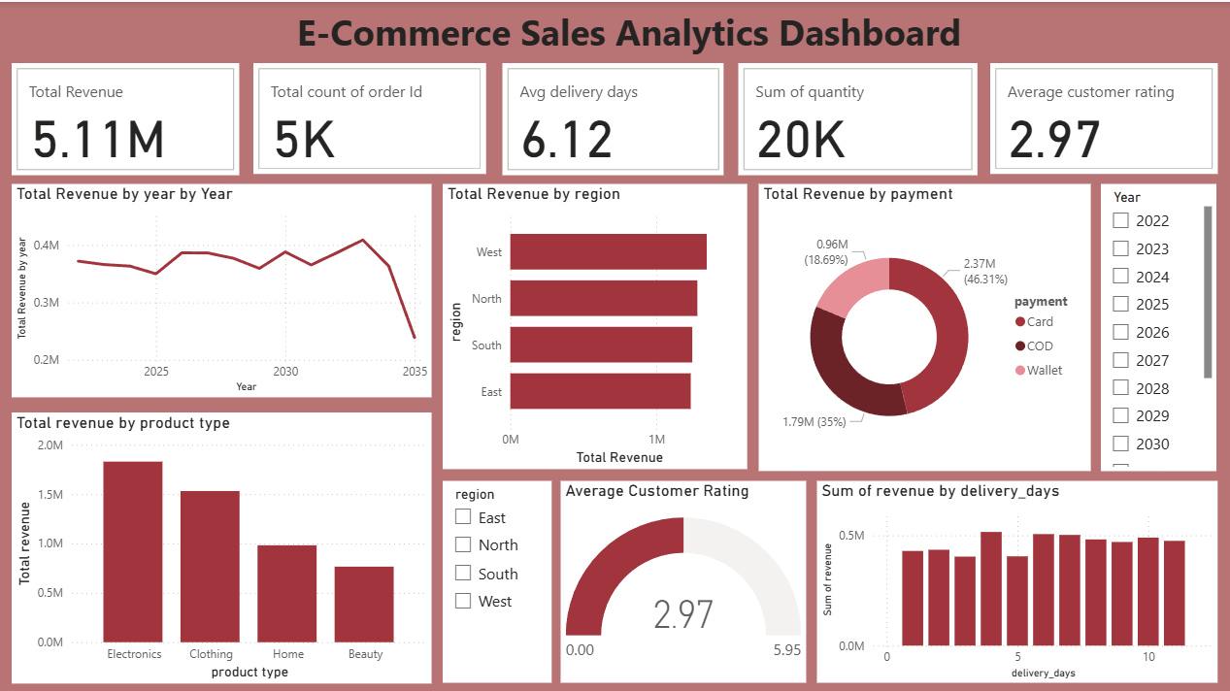

Dashboard Overview
Interactive Power BI Dashboard featuring:
1) KPI Cards: Total Revenue, Orders, Avg. Discount & Rating
2)Slicers: Filter by Region, Category, Date Range & Payment Method
3)Trend Analysis: Monthly revenue line chart with forecast
4)Category Breakdown: Bar chart by product category
5)Regional-Sales-Map: Geographic revenue distribution
6)Top Products: Ranked by revenue and quantity sold
7)Tool Used: Microsoft Power BI Desktop

Slide 4
Key Analytical Findings
5.11M
5K
2.97/5
Total Revenue
Total Orders
Avg. Customer Rating
The dashboard provides an interactive view of revenue, orders, product categories, regions, payment methods and customer ratings.

Slide 5


Thank You
Tool used: Micosoft Power BI

